Slide 1
Visual C++
Lecture 1 – Classes and Data Abstraction I

Slide 2
Outline
Introduction + Concepts
Class Definition
Class Scope and Accessing Class Members
Access and Utility Functions
Constructors with Default Arguments
Destructors
Returning a Reference to a Private Data Member
Default Memberwise Assignment

Slide 3
Introduction
In the previous course, you have learned the basic concepts for programming through control structures, functions, arrays …
In this course, you shall learn how to program through the object-oriented programming (OOP) approach.
OOP encapsulates data (attributes) and functions (behavior) into packages called classes.
A class is like a blueprint. Out of a blueprint, a builder can build a house. Out of a class, a programmer can build an object.

Slide 4
Introduction: Concepts
Data Abstraction:
It is about telling the user what a certain functionality does, and not about how that functionality is implemented.
Data Encapsulation:
The wrapping up of data and functions into a single unit called class. Encapsulation means that some or all of an object’s internal structure are hidden from the outside world.
Information Hiding:
Classes normally are not allowed to know how other classes are implemented; implementation details are hidden within the classes themselves.
For example, it is possible to drive a car effectively without knowing the details of how the engine, transmissions and exhaust systems work internally.

Slide 5
Class Definition
A class (in terms of files) is divided into two parts:
Header File (ClassName.h)
Source File (ClassName.cpp)
A header file contains the structure of the class.
A source file contains the implementation of the class.
A class (in terms of structure) can be divided into three parts:
private: attributes or functions cannot be accessed outside the class definition.
public: attributes or functions can be accessed outside the class definition.
protected: attributes or functions can be accessed from the inherited class (will be discussed in the Inheritance lecture).

Slide 6
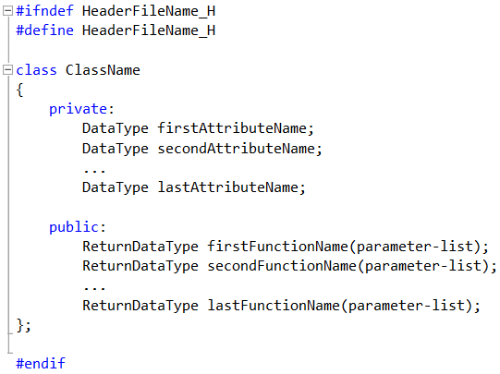
Class Definition: Header

Slide 7
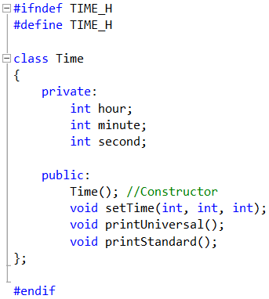
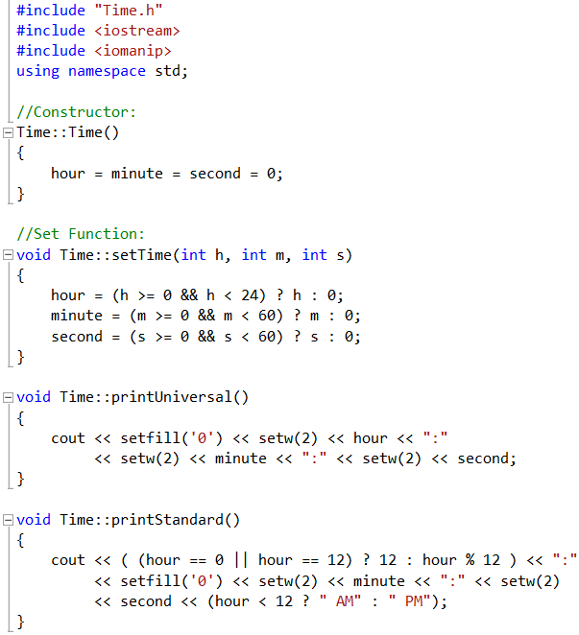
Class Definition: Time Class Example

Slide 8
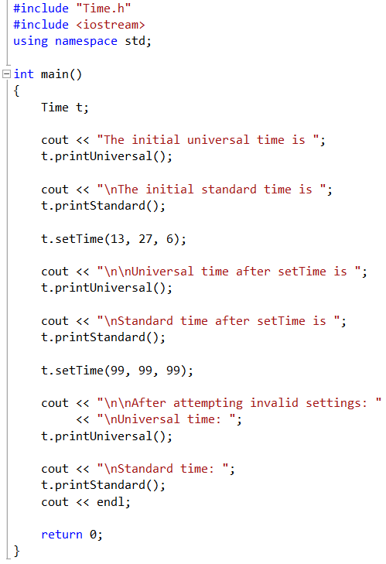
Class Definition: Time Class Example
Inside the main(), an object can be created by using the class name as a data type.
In this example, the class Time is used for creating the object t.
The object t can call the functions created within the class Time that are located under the public section.

Slide 9
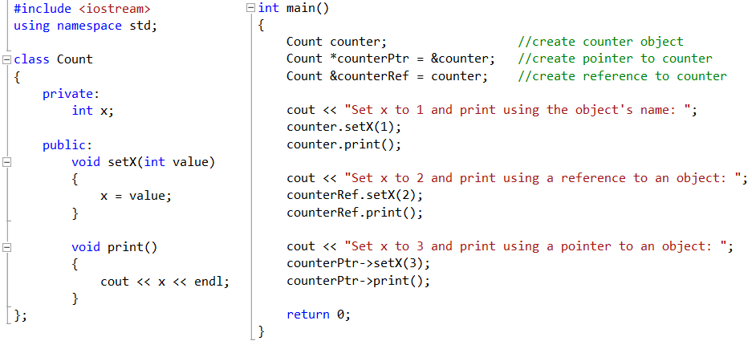
Class Scope and Accessing Class Members

Slide 10
Access and Utility Functions
In general, access functions are located in the class under the public section so that the user can access them.
Sometimes, you might need to create functions that are not accessible by the user, which will be placed under the private section of the class.
Such type of functions are called utility functions or helper functions. These functions will be used internally within the class only.

Slide 11
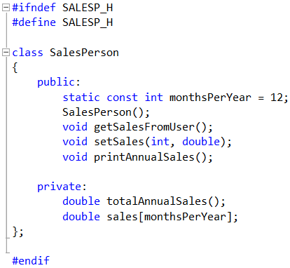
Access and Utility Functions Example
totalAnnualSales() is a utility or helper function since it is located under the private section of the class SalesPerson.
Utility functions can be used or called within the public functions.

Slide 12
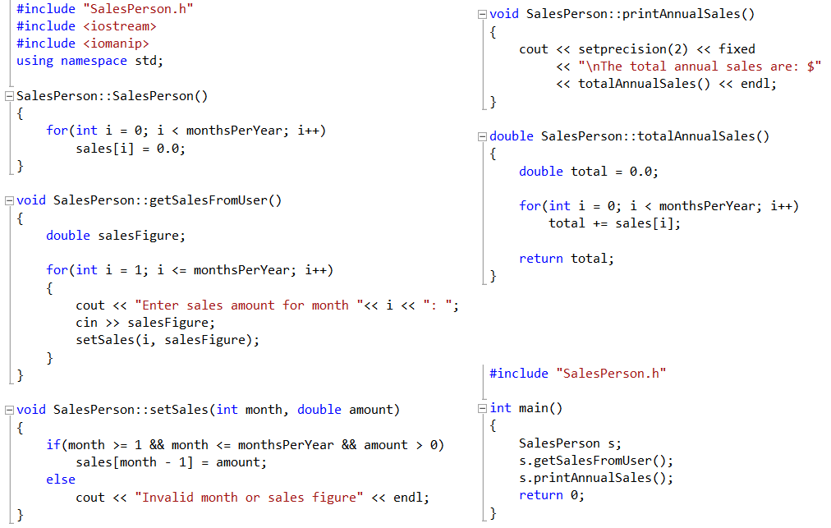
Access and Utility Functions Example

Slide 13
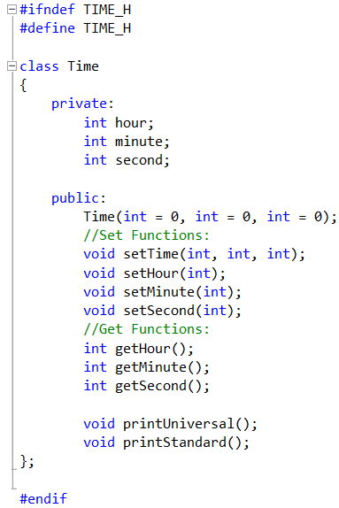
Constructors with Default Arguments
In the class Time, the constructor contains default values equal to 0 for the three integer arguments.
Set and Get Functions are introduced in the class.
Set functions allows the user to set values for the private members found in the class.
Get Functions allows the user to return the current values of the private members found in the class.

Slide 14
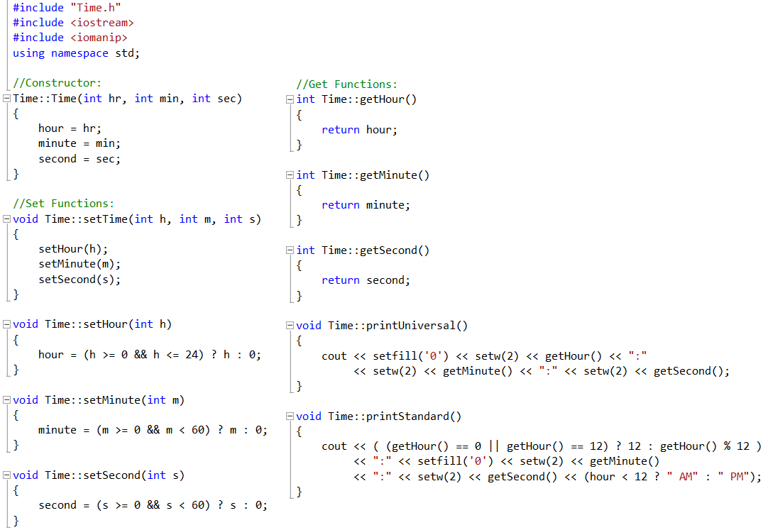
Constructors with Default Arguments

Slide 15
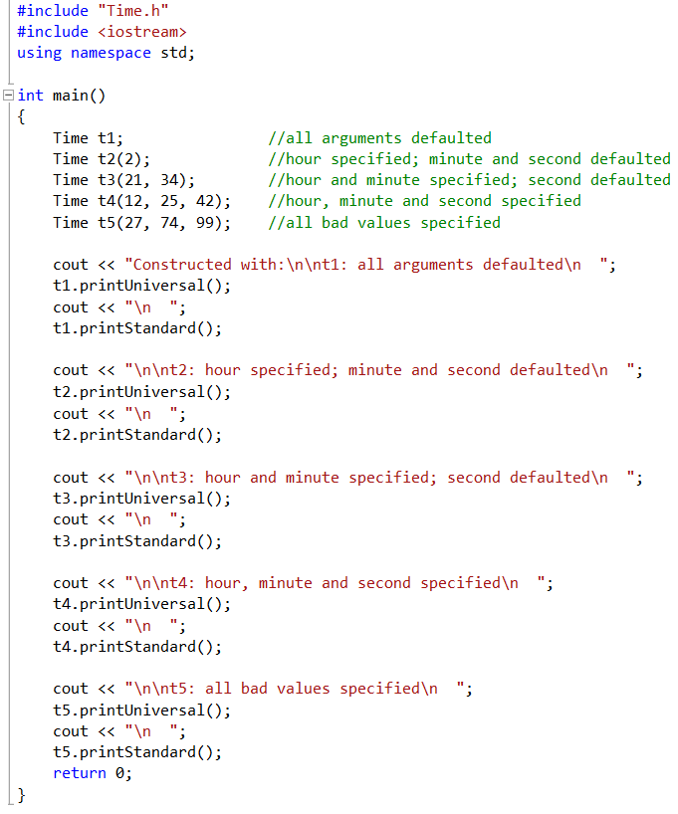
Constructors with Default Arguments
Inside the main(), five objects were created for the class Time.
Object t1 will take no arguments to the constructor.
Object t2 will take 1 argument to the constructor.
Object t3 will take 2 arguments to the constructor.
Object t4 will take 3 arguments to the constructor.
Object t5 will also take 3 arguments with bad values for the arguments hour, minute and second.

Slide 16
Destructors
A destructor is another type of special member function.
The name of the destructor for a class is the tilde character (~) followed by the class name.
A class’s destructor is called implicitly when an object is destroyed.
The destructor itself does not actually release the object’s memory, but performs termination housekeeping before the object’s memory is reclaimed.
The destructor receives no parameters and returns no value, not even void.

Slide 17
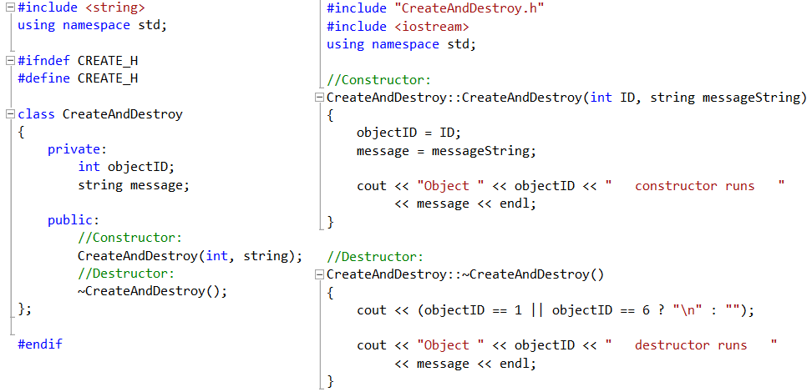
Destructors: Example

Slide 18
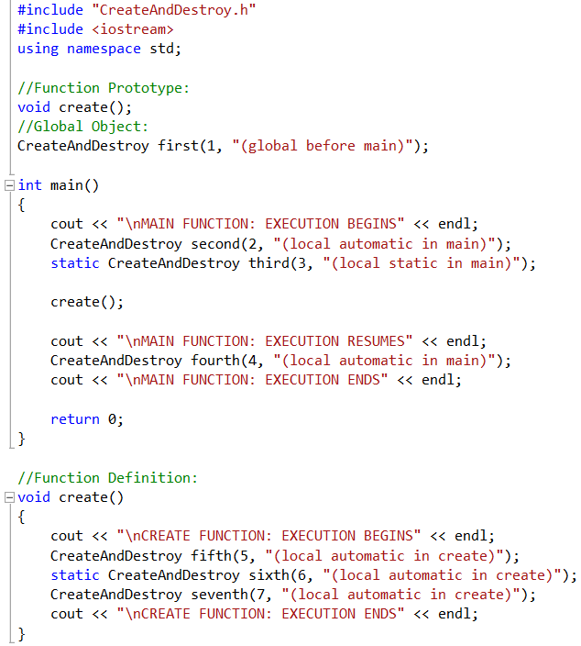
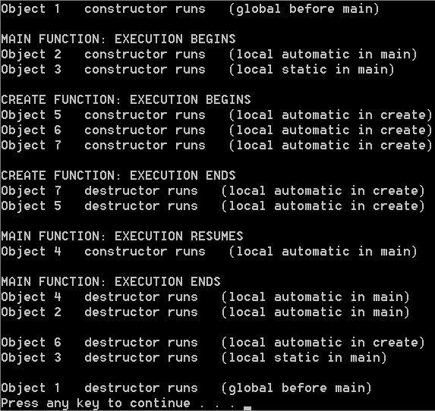
Destructors: Example

Slide 19
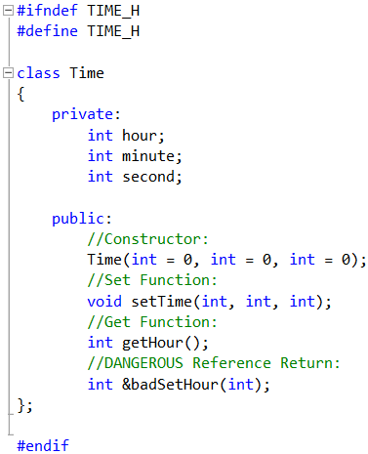
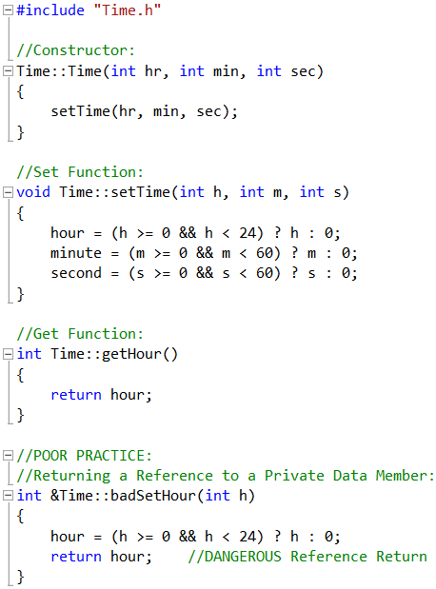
Returning a Reference to a Private Data Member

Slide 20
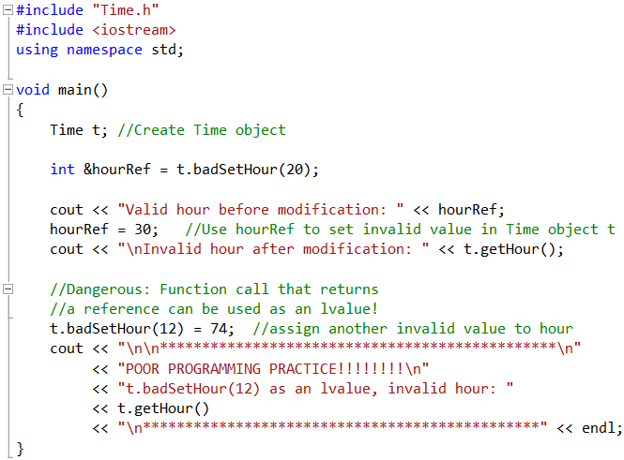
Returning a Reference to a Private Data Member
The reference variable hourRef is used to change the value of a private data member for the object t.
This is done through the call of the function badSetHour.
The definition of lvalue is referred to as “an object that can appear on the left-hand side of an assignment”.

Slide 21
Default Memberwise Assignment
The assignment operator (=) can be used to assign an object to another object of the same type.
By default, such assignment is performed by the memberwise assignment.
Each data member of the object on the right of the assignment operator is assigned individually to the same data member in the object on the left of the assignment operator.

Slide 22
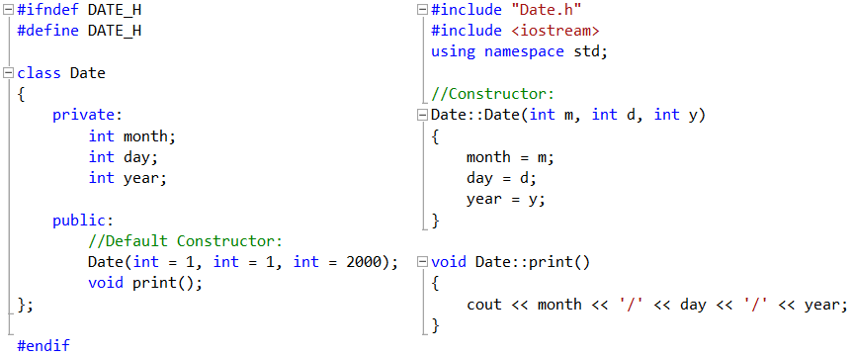
Default Memberwise Assignment: Example

Slide 23
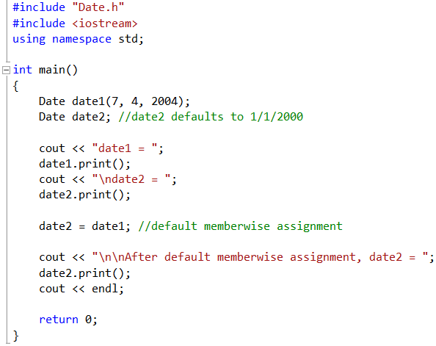
Default Memberwise Assignment: Example
Object date2 will take the default values given to the constructor.
date2 = date1 will override the values of the object date2 attributes with the values in the object date1.

Slide 24
Exercise 1: Rectangle Class
Create a class Rectangle with attributes length and width, each of which defaults to 1.
Provide member functions that calculate the perimeter and the area of the rectangle.
Also, provide set and get functions for the length and width attributes.
The set functions should verify that length and width are each floating-point numbers larger than 0.0 and less than 20.0.

Slide 25
Exercise 2: Enhancing Rectangle Class
Modify the class Rectangle created in exercise 1.
Add a predicate function called isSquare that determines whether the rectangle is a square.
Add a private attribute called chosenCharacter with a set function for the attribute.
Add another function called draw that draws a rectangle made of the character chosen by the user.

Slide 26
Exercise 3: Car Class
Create a class Car with the following attributes:
Brand Name: should be a character array of size 20.
Transmission Type: should be a Boolean attribute.
Fuel Consumption: should be a floating-point attribute.
Car Weight: should be an integer attribute.
The class Car should contain 4 member functions:
Two get functions: One returns the Transmission Type value and the other returns the Fuel Consumption value.
One set function: Sets the values of the class’s attributes.
Print Function: Prints the values of the class’s attributes.

